Slide 1

Major Project for Academic Session 2024-25 Facial Recognition in Voting Systems: A Biometric Approach to Prevent Electoral Fraud
Presented By
Project Guide
Aishwarya Parwekar (03)
Saloni Deshmukh (21)
Himanshu Katrojwar (36)
Dr. Rahul Agrawal
Associate Professor
DIC
Department of Data Science, IoT and Cyber Security
G H Raisoni College of Engineering

Slide 2
Contents
Introduction
Objectives
Literature Review
Proposed Methodology/ Architecture/Project Modules
Data Collection / Tools / Platform used
Design / Implementation / modelling
Testing and Summary of Results
Outcomes
Conclusion
Future Scope
References

Slide 3
INTRODUCTION
Voting as a Fundamental Right: Voting is crucial in democracies, ensuring citizen participation in governance, but faces challenges due to electoral fraud.
Challenges to Electoral Integrity: Issues like proxy voting, multiple voting, and voter impersonation undermine election legitimacy, highlighting the weaknesses of traditional verification methods.
Role of Face Verification Technology: Face recognition technology, leveraging unique biometric features, offers a secure alternative to manual identification, preventing fraudulent voting.
Research Objectives: This study aims to explore face verification for voting, addressing challenges like data privacy and security, to enhance electoral integrity and public trust.

Slide 4
OBJECTIVE
Address Challenges: Overcome technical and ethical obstacles related to data privacy, security, and infrastructure in face verification systems.
Enhance Electoral Integrity: Reduce electoral fraud (e.g., multiple and proxy voting) by face verification for secure voter authentication.
Boost Public Trust: Strengthen public confidence in elections by ensuring transparency, fairness, and security through biometric verification.
Provide Feasible Solutions: Propose practical solutions for implementing face verification in voting systems, addressing regulatory, privacy, and infrastructure concerns.

Slide 5
LITERATURE SURVEY
Ref | Journal | Published in | Title | Methodology
1 | IJRASET | 2024 | Online Voting System | Developed an online voting platform with security features.
2 | IJISRT | 2023 | Online Voting System using Face Recognition and OTP | Used Haar Cascade for face recognition, OTP for verification, and implemented with Python, Tkinter, SQLite, and OpenCV.
3 | IJNMT | 2022 | Implementation of OCR and Face Recognition on Mobile Based Voting System Application in Indonesia. | Combined OCR (regex-based) for ID extraction and MTCNN, FaceNet for face recognition.
4 | AIP Conference Proceedings, vol. 2405 | 2022 | Smart voting machine based on fingerprint and face recognition. | Employed both fingerprint and face recognition for voter authentication.
5 | IJSRST | 2021 | A Survey on Performing E-Voting through Facial Recognition. | Applied RNN and multi-output ridge regression for facial recognition, with Shamir's 1024-bit algorithm for security.
6 | JEPS-UTQ 10 | 2020 | A Secure and Authenticating E-Voting System Using Multiple Biometrics. | Used DNN for face matching and fingerprint training for authentication.

Slide 6
LITERATURE SURVEY
7 | IJRIE | 2020 | Smart voting web based application using face recognition, Aadhar and OTP verification | Implemented face recognition, Aadhar verification, and OTP for voter verification in a web-based voting app.
8 | International Journal of Scientific Research in Computer Science and Engineering | 2019 | Smart voting system through facial recognition | Utilized Eigenface, FisherFace, and SURF algorithms for facial recognition.
9 | Mehran University Research Journal of Engineering & Technology 37 | 2018 | A novel hybrid biometric electronic voting system: Integrating finger print and face recognition. | Integrated fingerprint and face recognition using Viola-Jones for feature extraction and PCA, K-NN for identity verification.
10 | International Journal of Emerging Technologies and Innovative Research | 2017 | Voters face recognition and fake rejection using digital image processing | Used geometric and feature-based approaches for face recognition and SVM for fake vote rejection.

Slide 7
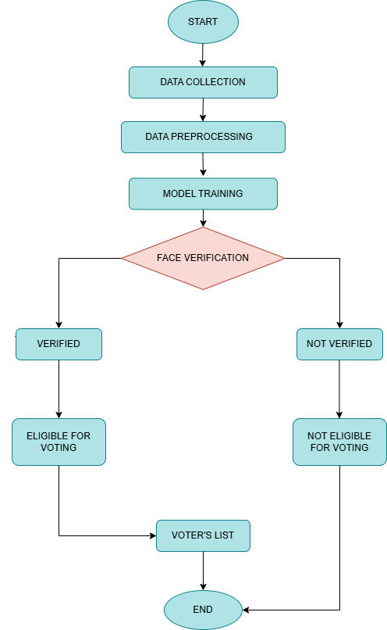
PROPOSED
METHODOLOGY

Slide 8
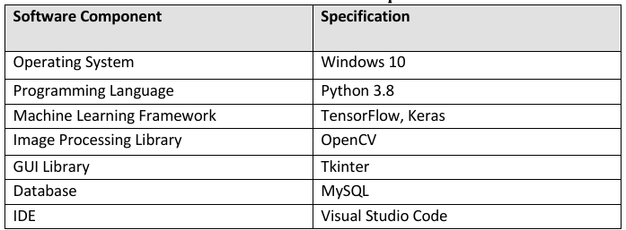
DATA COLLECTION / TOOLS/ PLATFORM USED
Data Collection: Facial images from diverse sources (Kaggle, Olivetti) ensure robust training, with additional data collected from eligible voters in the application.
Tools/ Platform Used: VS Code, Python, OpenCV, Tkinter and Google Colab

Slide 9
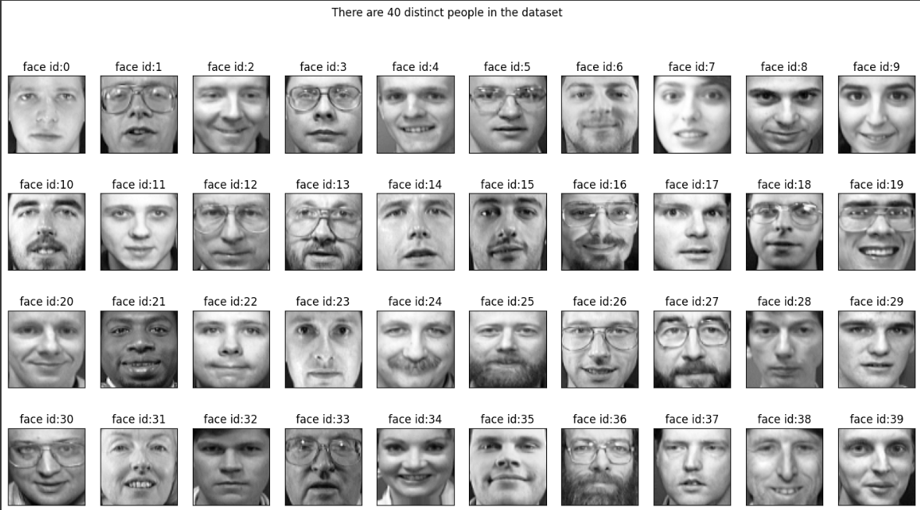
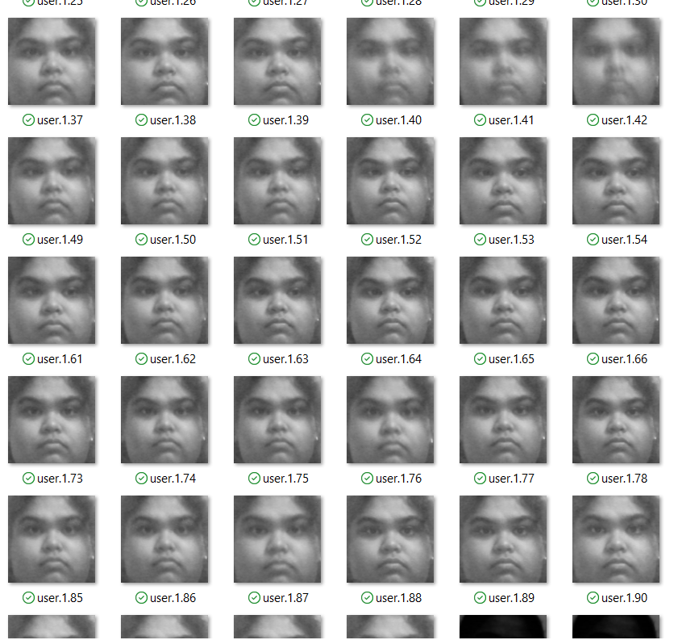
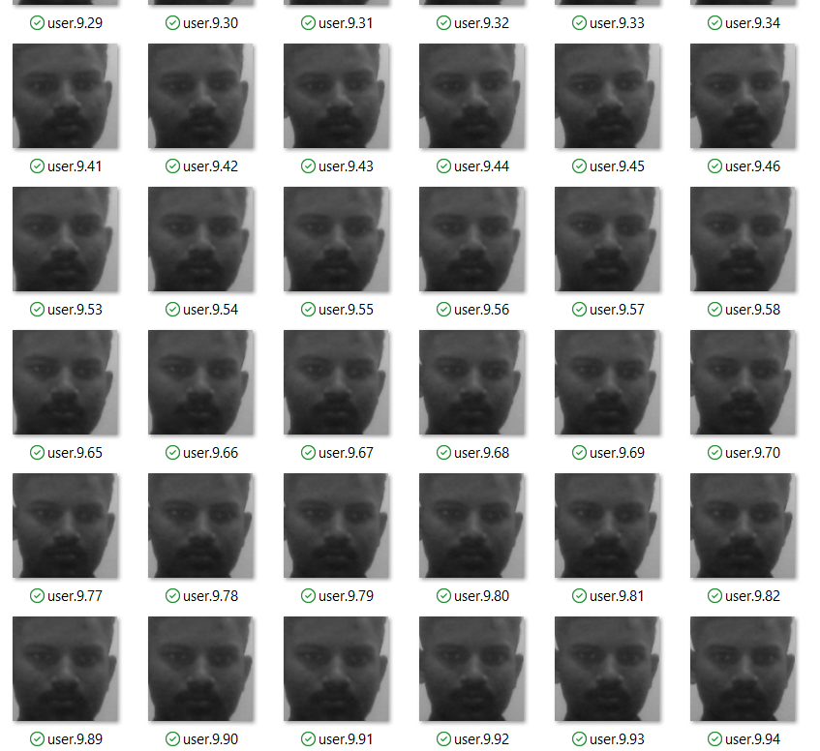
DATASET

Slide 10
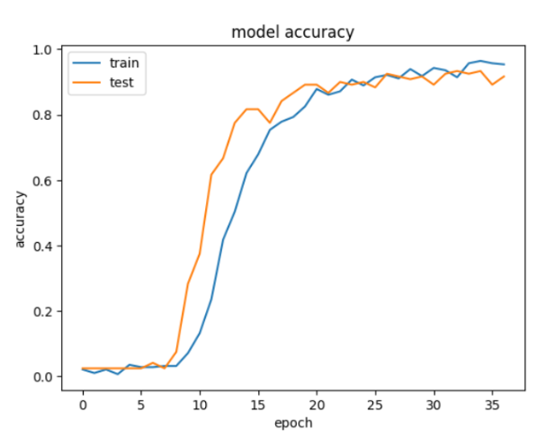
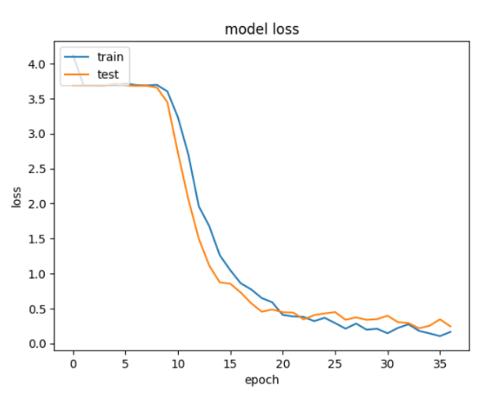
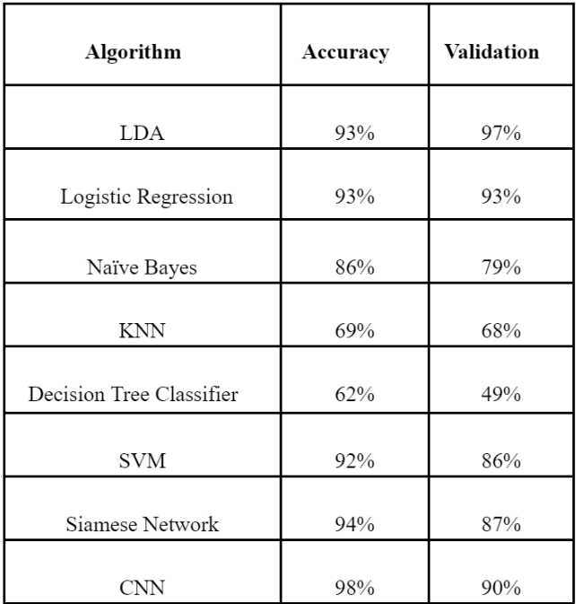
DESIGN / IMPLEMENTATION/ MODELLING
Data Collection: Facial images from diverse conditions (Kaggle, Olivetti) ensure robust model training and evaluation for model selection.
Data Preprocessing: Standardization, alignment, and noise reduction improve model accuracy and efficiency in face recognition.
CNN Implementation:
Why CNN?

Slide 11
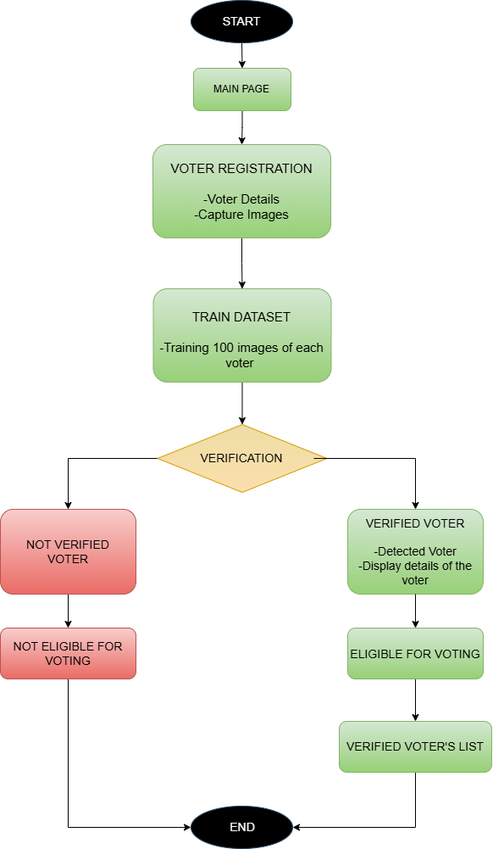

Slide 12
DESIGN / IMPLEMENTATION/ MODELLING
Registration: Voter details, including a photo, are initially entered and stored in the Voter Details module for identity records.
Verification at Polling Station: At the polling station, the system captures a live image of the voter using the Face Verification module. This live capture is used for real-time identity verification.
Verification Confirmation: If the system confirms the voter's identity, their data is moved to the Verified Voters list, authorizing them to cast their vote.
Post-Verification Handling: In case of failed verification, the voter can attempt another verification, or an official may manually verify their identity.
Verified Voters List: A list of verified voters is generated, displaying their name, date of birth, gender, voter ID, and verification status, making it clear who is eligible to vote.
Storing Voter Details: Verification data, including voter details and status, ensures traceability, transparency, auditing, and model accuracy improvement.

Slide 13
TESTING AND SUMMARY OF RESULTS
Testing Focus: CNN accuracy and Tkinter UI functionality, including Unit Testing, Integration Testing, and UAT.
Unit Testing: Verified core functions (image capture, face detection, database, CNN, real-time verification) with error handling.
Integration Testing: Ensured smooth end-to-end workflow and reliable UI-database interactions.
UAT: Achieved 98% accuracy in real-time verification with a user-friendly interface.
Results:
Efficiency: Verification time of 0.8 seconds.
Limitations: Minor lighting and pose issues, improved with retry options.
Scalability: Potential confirmed, further real-world testing recommended.
Suggestions: Improve lighting/pose handling, perform stress tests, and optimize CNN for scalability.

Slide 14
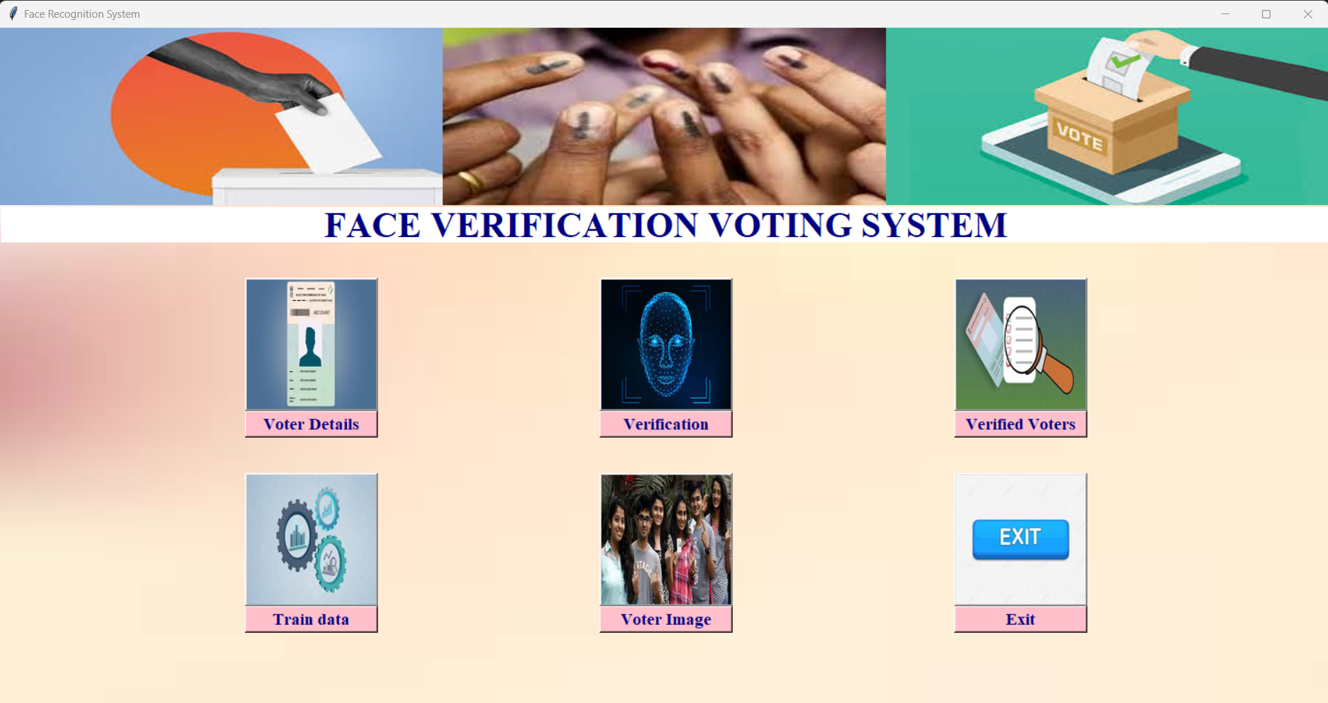
PROJECT IMPLEMENTATION

Slide 15
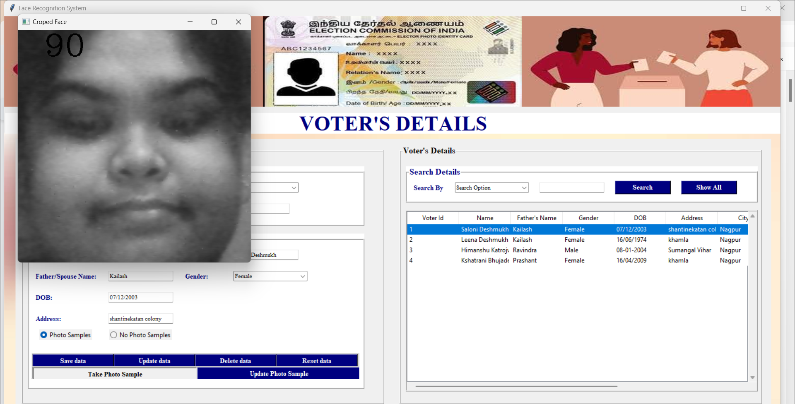
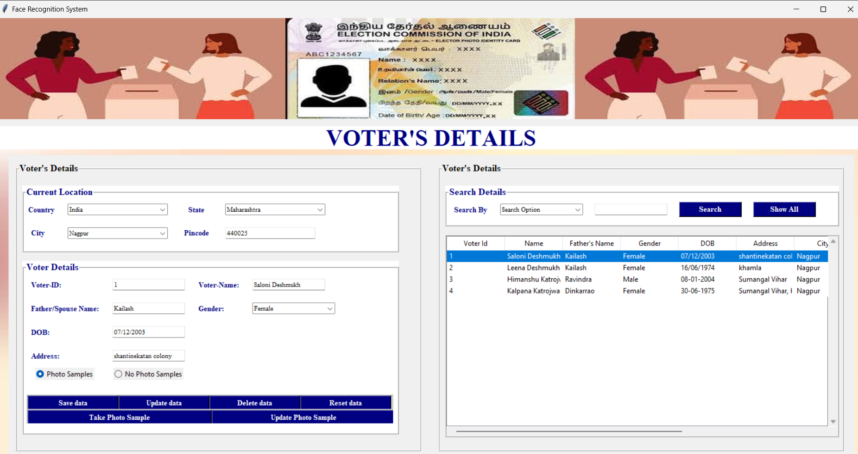
PROJECT IMPLEMENTATION

Slide 16
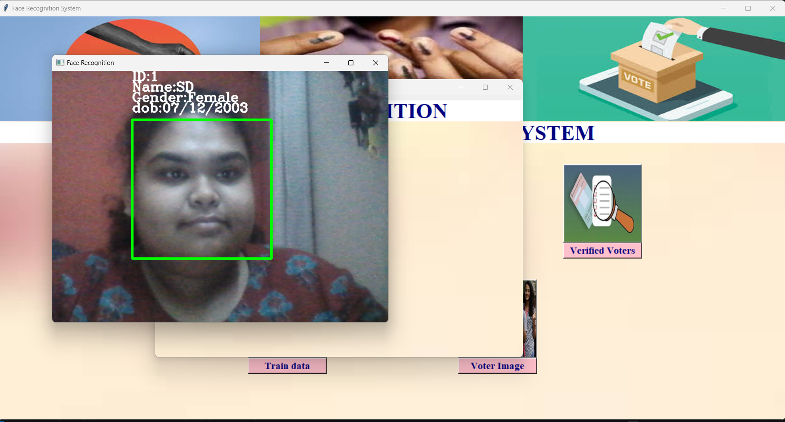
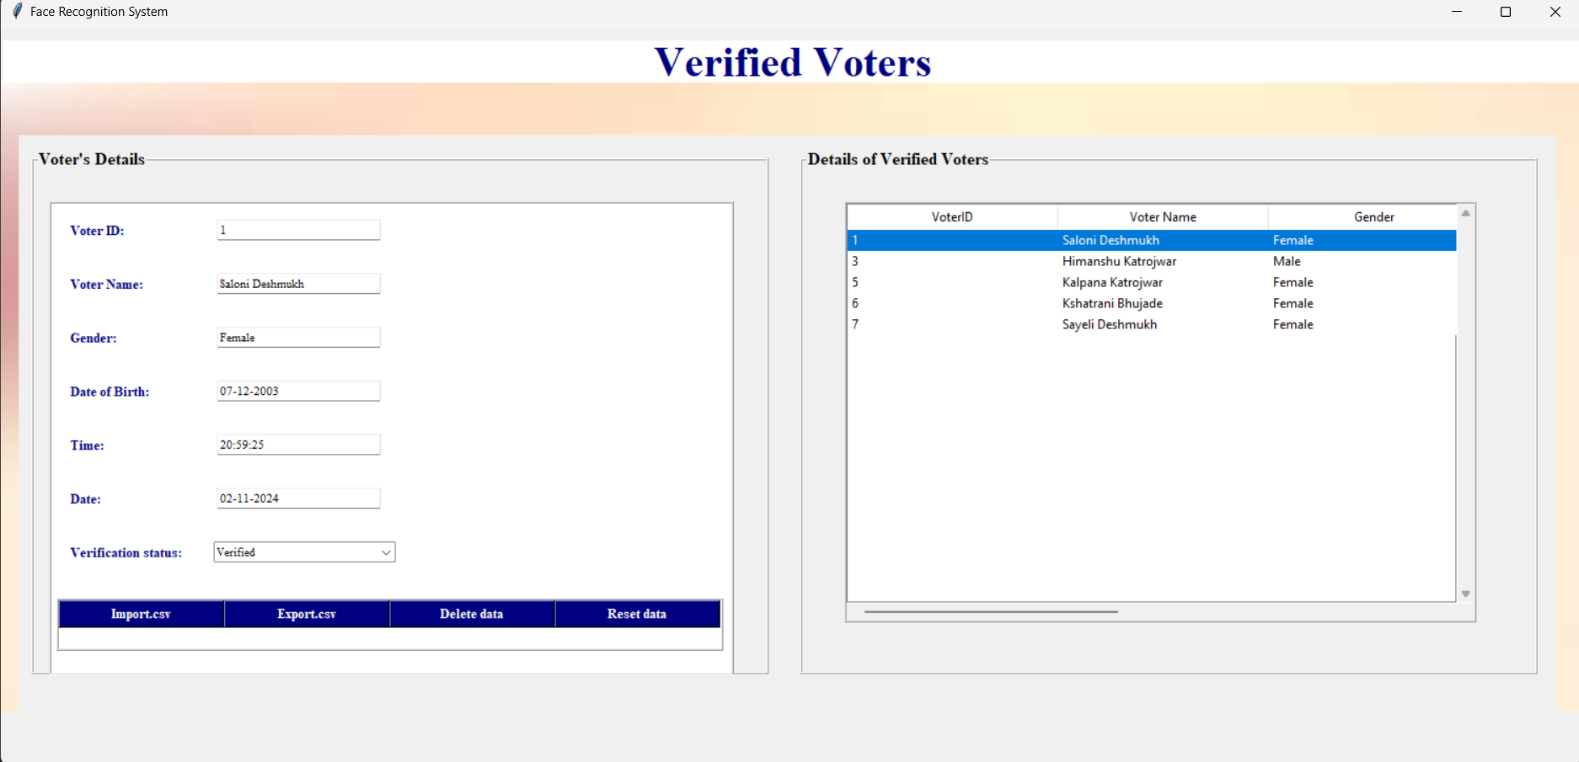
PROJECT IMPLEMENTATION

Slide 17
OUTCOMES
High Accuracy: Achieved 98% accuracy in real-time voter verification under varying conditions.
Efficient Processing:The system performed verification in 0.8 seconds, ensuring fast and reliable authentication.
User-Friendly Interface: Tkinter UI provided an intuitive and responsive experience, aiding smooth user interactions.
Robust Error Handling:Effective handling of potential errors, including lighting and pose variations, ensuring smoother verification processes.
Scalability Potential:System demonstrated scalability for real-world applications, though further stress testing is recommended for large-scale deployment.
Identified Limitations:Minor issues in lighting and pose variations, addressed by retry mechanisms to improve accuracy.

Slide 18
CONCLUSION
Enhanced Voting Security: Face verification technology, using CNNs, significantly improves the security and integrity of voting systems by preventing fraudulent activities like proxy and multiple voting.
Accurate and Efficient: The system demonstrated 98% accuracy in real-time verification with minimal delays (0.8 seconds), ensuring reliable voter authentication.
User-Friendly Interface: The intuitive Tkinter interface made the system easy to navigate, with effective error handling and smooth integration of functionalities.
Future Potential: While some limitations exist under varying conditions (e.g., lighting, pose variations), the system shows great promise for real-world application in secure, scalable elections.
Further Research: Continued refinement, especially for challenging real-world environments, will enhance its practical application and adoption in global electoral processes.

Slide 19
FUTURE SCOPE
Enhanced System Robustness: Expansion to support larger datasets and diverse demographics, with improved algorithms for varying conditions (lighting, aging, expressions) to boost adaptability and accuracy.
Strengthened Security and Privacy: Integration of additional biometrics (fingerprint, iris) for higher security, and privacy-preserving methods (homomorphic encryption, federated learning) to protect sensitive data.
Adaptability for Remote Voting: Potential adaptation for secure, transparent online or remote voting, along with research on legal and ethical considerations to guide policy development.
Multimodal Biometric Integration: Combines fingerprint, iris, and facial recognition for higher security and accuracy.
Edge and Mobile Usage: Enhances accessibility with real-time, on-device processing for remote areas.
Advanced Anti-Spoofing: Adds 3D facial recognition and liveness detection to prevent unauthorized access.
Data Privacy & Security: Protects voter data with anonymization, encryption, and federated learning to build public trust.

Slide 20
REFERENCES
[1] Singh, B., K. Sh Ranjan, and D. Aggarwal. ”Smart voting web based application using face recognition, Aadhar and OTP verification.” International Journal of Research in Industrial Engineering 9, no. 3 (2020): 260-270.
[2] Dhaher, Fatimah Ajeel, and Kadhim Hasen Kuban. ”A Secure and Authenticating E-Voting System Using Multiple Biometrics.” Journal of Education for Pure Science-University of Thi-Qar 10, no. 1 (2020): 253-261.
[3] Hopal, Pratik, Alkesh Kothar, Swamini Pimpale, Pratiksha More, and Jaydeep Patil. ”A Survey on Performing E-Voting through Facial Recognition.” (2021).
[4] Fortuna, Inggrid, and Yaman Khaeruzzaman. ”Implementation of OCR and Face Recognition on Mobile Based Voting System Application in Indonesia.” IJNMT (International Journal of New Media Technology) 9, no. 1 (2022): 20-27.
[5] Badode, Nikita, Prakash Pathak, Nitish Verma, Nikita Gund, and S. L. Dawakhar. ”Online Voting System using Face Recognition and OTP.”
[6] Janarthanan, M., Archana Raghunath, S. Aiswarya, and E. Sajitha. ”Smart voting machine based on fingerprint and face recognition.” In AIP Conference Proceedings, vol. 2405, no. 1. AIP Publishing, 2022.
[7] Choudhary, Nilam, Shikhar Agarwal, and Geerija Lavania. ”Smart voting system through facial recognition.” International Journal of Scientific Research in Computer Science and Engineering 7, no. 2 (2019): 7-10.
[8] Najam, Syed Shahram, Aamir Zeb Shaikh, and Shabbar Naqvi. ”A novel hybrid biometric electronic voting system: Integrating finger print and face recognition.” Mehran University Research Journal of Engineering & Technology 37, no. 1 (2018): 59-68.
[9] ”Voters face recognition and fake rejection using digital image processing”, International Journal of Emerging Technologies and Innovative Research (www.jetir.org — UGC and issn Approved), ISSN:2349-5162, Vol.4, Issue 7, page no. pp38-43, July-2017
[10] Voram Bhavan, Laxmi Koli, Lanka Rishi, Marri Sankeerth Reddy.”Online Voting System”, Volume 10, Issue VI, International Journal for Research in Applied Science and Engineering Technology (IJRASET) Page No: 1075-1077, ISSN : 2321-9653.

Slide 21
Thank You!

